Slide 1



Supervised Learning: Regression
Supervised learning is a powerful machine learning technique where an algorithm is trained on labeled data to make predictions on new, unseen data. Regression, a type of supervised learning, focuses on predicting continuous numerical values.

Slide 2

Introduction to Regression
1
Predicting Numerical Outputs
2
Finding Relationships
Regression models learn to map input variables to continuous output variables, like predicting house prices or stock prices.
Regression analyzes the relationship between multiple variables to uncover patterns and insights hidden in data.
3
Making Forecasts
Regression techniques can be used to make predictions about future events based on historical data.

Slide 3

Linear Regression
Model Equation
1
Linear regression models the relationship between variables as a straight line: y = mx + b
Fitting the Line
2
The model finds the line of best fit that minimizes the distances between data points and the line.
Prediction
3
Once the model is trained, it can use the linear equation to predict new y values from x.

Slide 4
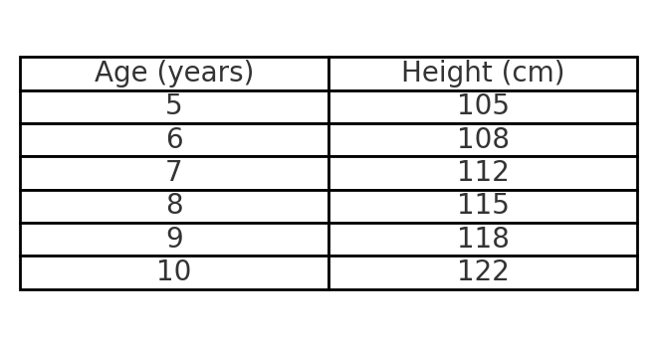
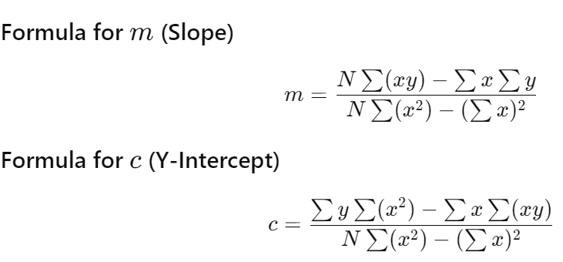
The formula for the simple linear regression line is: y=mx+c , where:
y is the predicted value (height).
x is the input value (age).
m is the slope of the line.
c is the y-intercept.

Slide 5
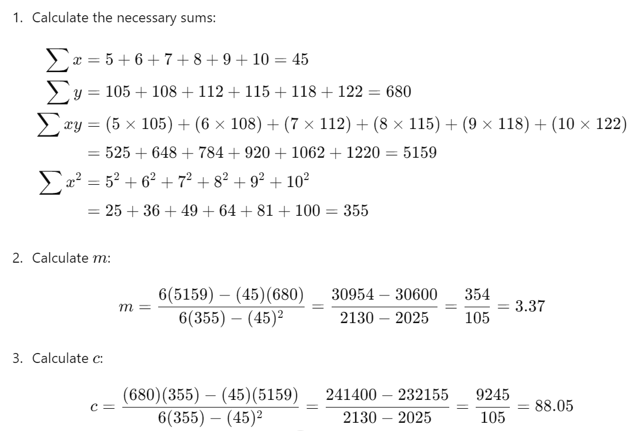

Slide 6
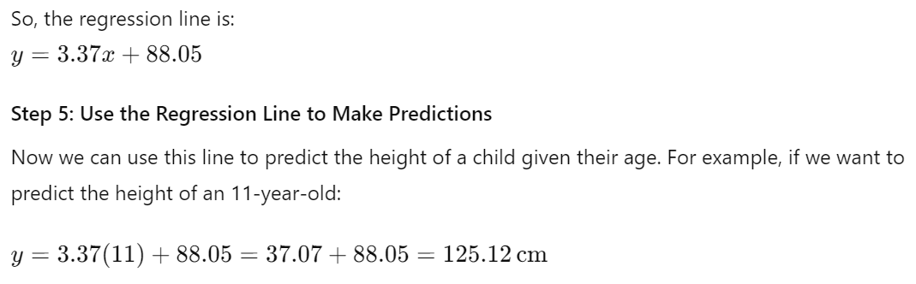

Slide 7
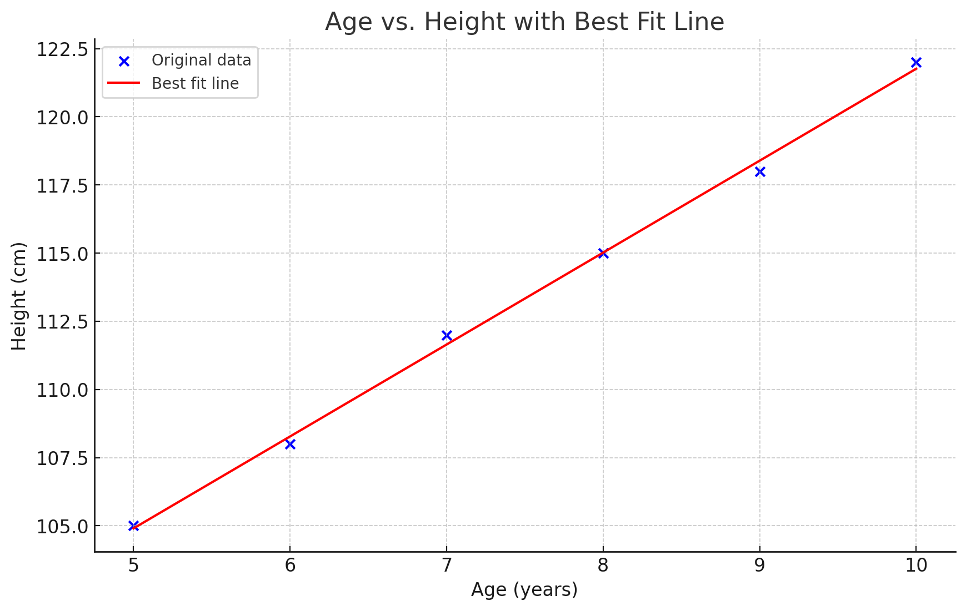

Slide 8
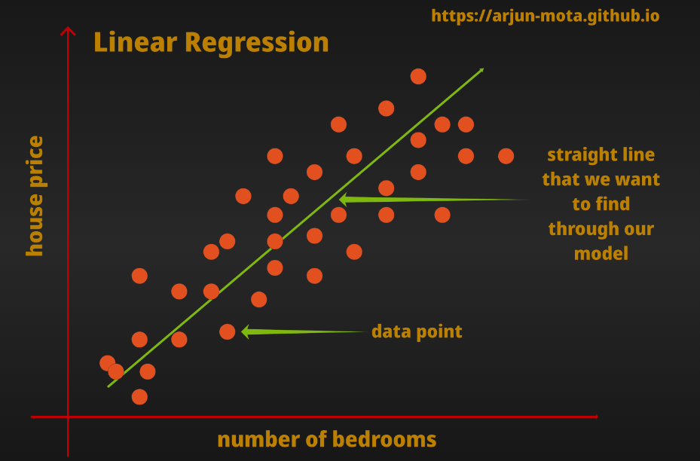

Slide 9

Linear Regression Code and Graph
Code Snippet
Visualization
from sklearn.linear_model import LinearRegression
model = LinearRegression()
model.fit(X_train, y_train)
y_pred = model.predict(X_test)
A scatter plot of the data with the linear regression line overlaid provides a clear visual representation of the model's fit.

Slide 10




Multiple Linear Regression
Expanded Model
Multiple linear regression allows for the inclusion of multiple independent variables to predict the dependent variable.
Equation
The model equation becomes: y = b0 + b1*x1 + b2*x2 + ... + bn*xn
Interpretation
The coefficients (b1, b2, etc.) represent the change in y for a one-unit change in the corresponding x variable.

Slide 11
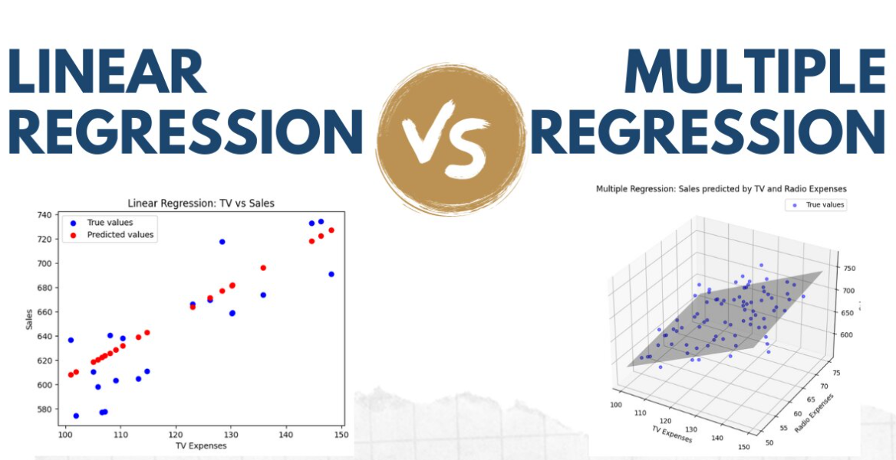

Slide 12



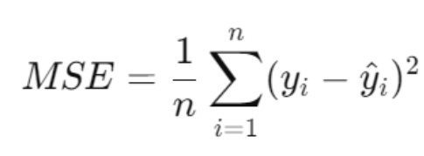
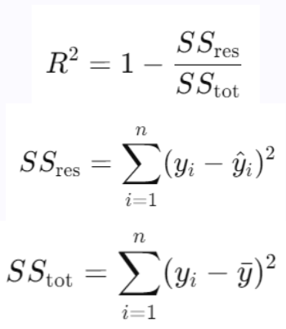
Model Evaluation
MSE and R²
Mean Squared Error (MSE)
R-squared (R²)
MSE measures the average of the squares of the errors, providing a metric for model accuracy.
R² represents the proportion of the variance in the dependent variable that is predictable from the independent variables.

Slide 13
Applications and Use Cases
Predictive Analytics
Risk Assessment
Optimization
Regression models are used to forecast future trends, predict sales, and estimate demand for products and services.
Regression is employed in finance to assess credit risk, evaluate insurance claims, and analyze investment portfolios.
Regression techniques help organizations optimize operations, resource allocation, and business processes to improve efficiency.

